Slide 1

Department : Electrical Engineering
Government Polytechnic west Champaran
MATLAB
subject code: 2020409

Slide 2
Content
Introduction
MATLAB Environment
MATLAB as a Calculator
MATLAB Online
Syntax and Semantics
Help
Plotting

Slide 3
Introduction
MATLAB (MATrix LABoratory) is an efficient user-friendly interactive software package, which is very effective for solving engineering, mathematical, and system problems.
MATLAB Windows
The assumption here is that the reader is sitting in front of an active computer and MATLAB is installed. To begin MATLAB, double click the MATLAB icon on the computer’s desktop or select MATLAB from the Start or Program menu. Immediately a special window called the MATLAB desktop appears as below.

Slide 4
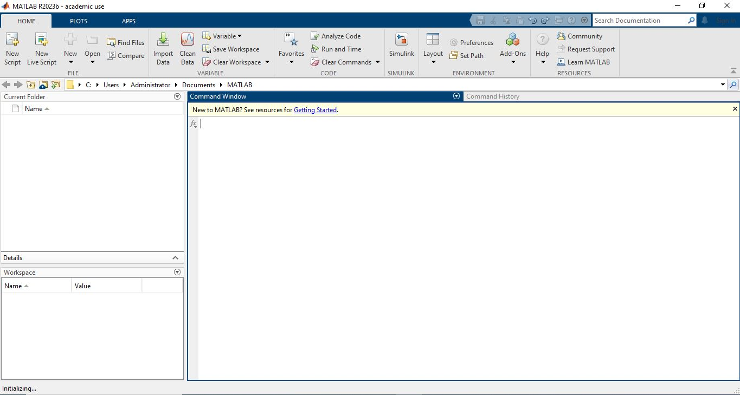
MATLAB Environment
The Command Window
The Command History
The Workspace
The Current Directory

Slide 5
Matlab as a Calculator
Let’s start at the very beginning. For example, let’s suppose you want to calculate the expression, 1 + 2 × 3. You type it at the prompt command (>>) as follows,
>> 1+2*3
Ans=
7
You will have noticed that if you do not specify an output variable, MATLAB uses a default variable ans, short for answer, to store the results of the current calculation.

Slide 6
Matlab Operation
Symbol | Operation | Example | Answer
+ | Addition | 3+6 | 12
- | Subtraction | 9-4 | 5
* | Multiplication | 3*3 | 9
/ | Division | 9/3 | 3
Quitting MATLAB
To end your MATLAB session, type quit in the Command Window, or select File −→ Exit MATLAB in the desktop main menu.

Slide 7
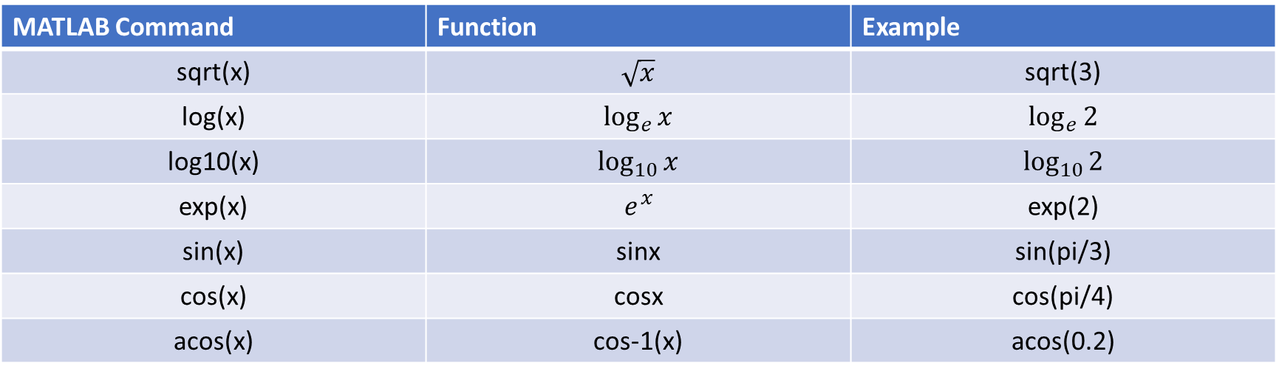
Mathematical Functions
MATLAB Command | Function | Example
sqrt(x) | $$\sqrt{x}$$ | sqrt(3)
log(x) | $$\log_{e}{x}$$ | $$\log_{e}{2}$$
log10(x) | $$\log_{10}{x}$$ | $$\log_{10}{2}$$
exp(x) | $$e^{x}$$ | exp(2)
sin(x) | sinx | sin(pi/3)
cos(x) | cosx | cos(pi/4)
acos(x) | cos-1(x) | acos(0.2)

Slide 8
home, clc, clear command
>>home
Home moves the cursor to the upper-left corner of the command window. You can use the scroll bar to see the history of previous functions.
>>clc
clc clears all the input from the Command Window display, giving you “clean display”. After using clc, you cannot use scroll bar to see the history of functions. But you till can use the up arrow to recall statements from the Command history
>>clear
Clear removes all variables from workspace. This free up system memory.

Slide 9
Different Format

Slide 10
format short, format long, format bank, format rat

Slide 11
Difference between fix, round, ceil, and floor commands
>> round(6.628)
ans = 7
round command rounds the element of x to towards nearest integer
>> fix(6.628)
ans = 6
fix command rounds the element x to nearest integer towards zero
>> ceil(6.628)
ans = 7
ceil command rounds the element x to nearest integer towards infinity
>> floor(6.628)
ans = 6
floor command rounds the element x to nearest integer towards minus infinity

Slide 12
Basic Plotting
MATLAB has an excellent set of graphic tools. Plotting a given data set or the results of computation is possible with very few commands.
Creating simple plots
basic MATLAB graphing procedure, for example in 2D, is to take a vector of xcoordinates, x = (x1, . . . , xN ), and a vector of y-coordinates, y = (y1, . . . , yN ), locate the points (xi , yi), with i = 1, 2, . . . , n and then join them by straight lines. You need to prepare x and y in an identical array form; namely, x and y are both row arrays or column arrays of the same length.

Slide 13
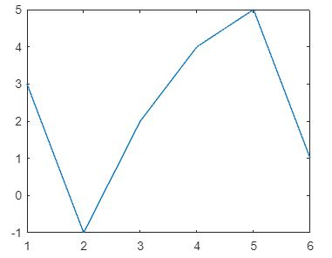
Continue…..
The MATLAB command to plot a graph is plot(x,y). The vectors x = (1, 2, 3, 4, 5, 6) and y = (3, −1, 2, 4, 5, 1) produce the picture shown in Figure 2.1.
>> x = [1 2 3 4 5 6];
>> y = [3 -1 2 4 5 1];
>> plot(x,y)

Slide 14
Continue….
>>x = 0:pi/100:2*pi;
>> y = sin(x);
>> plot(x,y)
Notes:
• 0:pi/100:2*pi yields a vector that
– starts at 0,
– takes steps (or increments) of π/100,
– stops when 2π is reached.
• If you omit the increment, MATLAB automatically increments by 1.

Slide 15
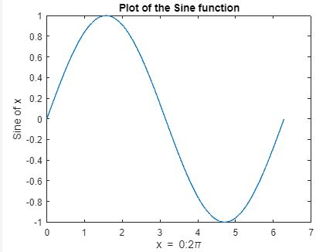
Adding titles, axis labels, and annotations
MATLAB enables you to add axis labels and titles. For example, using the graph from the previous example, add an x- and y-axis labels.
>> x = 0:pi/100:2*pi;
>> y = sin(x);
>> plot(x,y)
>> xlabel(’x = 0:2\pi’)
>> ylabel(’Sine of x’)
>> title(’Plot of the Sine function’)

Slide 16
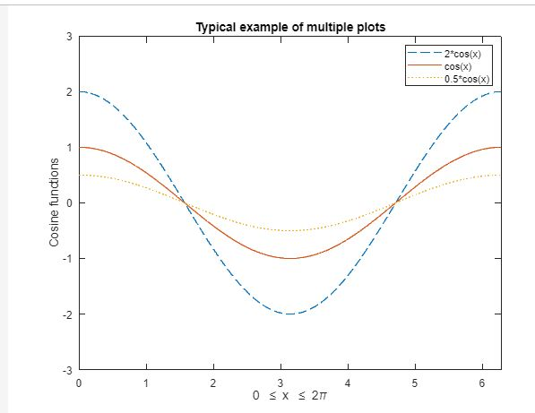
Multiple data sets in one plot
Multiple (x, y) pairs arguments create multiple graphs with a single call to plot. For example, these statements plot three related functions of x: y1 = 2 cos(x), y2 = cos(x), and y3 = 0.5 ∗ cos(x), in the interval 0 ≤ x ≤ 2π.
>> x = 0:pi/100:2*pi;
>> y1 = 2*cos(x);
>> y2 = cos(x);
>> y3 = 0.5*cos(x);
>> plot(x,y1,’--’,x,y2,’-’,x,y3,’:’)
>> xlabel(’0 \leq x \leq 2\pi’)
>> ylabel(’Cosine functions’)
>> legend(’2*cos(x)’,’cos(x)’,’0.5*cos(x)’)
>> title(’Typical example of multiple plots’)
>> axis([0 2*pi -3 3])

Slide 17
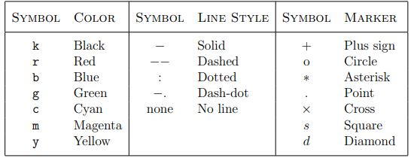
Specifying line styles and colors
It is possible to specify line styles, colors, and markers (e.g., circles, plus signs, . . . ) using the plot command:
plot(x,y,’style_color_marker’)

Slide 18
Thank you

