Slide 1

Department : Electrical Engineering
Government Polytechnic west Champaran
MATLAB
subject code: 2020409

Slide 2
Content
Arrays & Matrices
Entering a matrix
Matrix indexing
Colon operator
Linear spacing
Colon operator in a matrix
Creating a sub-matrix
Deleting row or column
Dimension
Transposing a matrix
Concatenating matrices
Matrix generators

Slide 3
Arrays & Matrices
Matrices are the basic elements of the MATLAB environment. A matrix is a two-dimensional array consisting of m rows and n columns. Special cases are column vectors (n = 1) and row vectors (m = 1).
Entering a vector
>> v = [1 4 7 10 13]
v =
1 4 7 10 13
Column vectors are created in a similar way, however, semicolon (;) must separate the components of a column vector
>> w = [1;4;7;10;13]

Slide 4
Continuation
w =
1
4
7
10
13
On the other hand, a row vector is converted to a column vector using the transpose operator. The transpose operation is denoted by an apostrophe or a single quote (’).

Slide 5
Continuation
>> w = v’
w =
1
4
7
10
13
Thus, v(1) is the first element of vector v, v(2) its second element, and so forth.

Slide 6
Continuation
to access blocks of elements, we use MATLAB’s colon notation (:). For example, to access the first three elements of v, we write,
>> v(1:3)
ans =
1 4 7
Or, all elements from the third through the last elements,
>> v(3:end)
ans =
7 10 13

Slide 7
Continuation
where end signifies the last element in the vector. If v is a vector, writing
>> v(:)
produces a column vector, where as writing
>> v(1:end)
produces a row vector.

Slide 8
Entering a matrix
A matrix is an array of numbers. To type a matrix into MATLAB you must
• begin with a square bracket, [
• separate elements in a row with spaces or commas (,)
• use a semicolon (;) to separate rows
• end the matrix with another square bracket, ].
>> A = [1 2 3; 4 5 6; 7 8 9]

Slide 9
Continuation
MATLAB then displays the 3 × 3 matrix as follows,
A =
1 2 3
4 5 6
7 8 9
Note that the use of semicolons (;) here is different from their use mentioned earlier to suppress output or to write multiple commands in a single line.

Slide 10
Continuation
We can then view a particular element in a matrix by specifying its location. We write,
>> A(2,1)
ans =
4
A(2,1) is an element located in the second row and first column. Its value is 4.

Slide 11
Matrix indexing
We select elements in a matrix just as we did for vectors, but now we need two indices. The element of row i and column j of the matrix A is denoted by A(i,j). Thus, A(i,j) in MATLAB refers to the element Aij of matrix A. The first index is the row number and the second index is the column number. For example, A(1,3) is an element of first row and third column. Here, A(1,3)=3.
Correcting any entry is easy through indexing. Here we substitute A(3,3)=9 by A(3,3)=0.

Slide 12
Continuation
>> A(3,3) = 0
A =
1 2 3
4 5 6
7 8 0
Single elements of a matrix are accessed as A(i,j), where i ≥ 1 and j ≥ 1. Zero or negative subscripts are not supported in MATLAB.

Slide 13
Colon operator
The colon operator will prove very useful and understanding how it works is the key to efficient and convenient usage of MATLAB. It occurs in several different forms.
Often we must deal with matrices or vectors that are too large to enter one element at a time. For example, suppose we want to enter a vector x consisting of points (0, 0.1, 0.2, 0.3, · · · , 5). We can use the command
>> x = 0:0.1:5;
The row vector has 51 elements.

Slide 14
Linear spacing
On the other hand, there is a command to generate linearly spaced vectors: linspace. It is similar to the colon operator (:), but gives direct control over the number of points. For example,
y = linspace(a,b)
generates a row vector y of 100 points linearly spaced between and including a and b.
y = linspace(a,b,n)
generates a row vector y of n points linearly spaced between and including a and b. This is useful when we want to divide an interval into a number of subintervals of the same length. For example

Slide 15
Continuation
>> theta = linspace(0,2*pi,101)
divides the interval [0, 2π] into 100 equal subintervals, then creating a vector of 101 elements.

Slide 16
Colon operator in a matrix
The colon operator can also be used to pick out a certain row or column. For example, the statement A(m:n,k:l specifies rows m to n and column k to l. Subscript expressions refer to portions of a matrix. For example,
>> A(2,:)
ans =
4 5 6
is the second row elements of A.
The colon operator can also be used to extract a sub-matrix from a matrix A.

Slide 17
Continuation
>> A(:,2:3)
ans = 2 3
5 6
8 0
A(:,2:3) is a sub-matrix with the last two columns of A. A row or a column of a matrix can be deleted by setting it to a null vector, [ ].
>> A(:,2)=[]
ans =
1 3
4 6
7 0

Slide 18
Creating a sub-matrix
To extract a submatrix B consisting of rows 2 and 3 and columns 1 and 2 of the matrix A, do the following.
>> B = A([2 3],[1 2])
B =
4 5
7 8
To interchange rows 1 and 2 of A, use the vector of row indices together with the colon operator.

Slide 19
Continuation
>> C = A([2 1 3],:)
C =
4 5 6
1 2 3
7 8 0
It is important to note that the colon operator (:) stands for all columns or all rows. To create a vector version of matrix A, do the following.

Slide 20
Continuation
>> A(:)
ans =
1
2
3
4
5
6
7
8
0

Slide 21
Continuation
The submatrix comprising the intersection of rows p to q and columns r to s is denoted by A(p:q,r:s).
As a special case, a colon (:) as the row or column specifier covers all entries in that row or column; thus
A(:,j) is the jth column of A, while
A(i,:) is the ith row, and
A(end,:) picks out the last row of A.
The keyword end, used in A(end,:), denotes the last index in the specified dimension. Here are some examples.

Slide 22
Continuation
>> A >> A(end:-1:1,end)
1 2 3 ans =
4 5 6 9
7 8 9 6
>> A(2:3,2:3) 3
ans = >> A([1 3],[2 3])
5 6 ans =
8 9 2 3
8 9

Slide 23
Deleting row or column
To delete a row or column of a matrix, use the empty vector operator, [ ].
>> A(3,:) = []
A =
1 2 3
4 5 6
Third row of matrix A is now deleted. To restore the third row, we use a technique for creating a matrix.

Slide 24
Continuation
>> A = [A(1,:);A(2,:);[7 8 0]]
A =
1 2 3
4 5 6
7 8 0
Matrix A is now restored to its original form.

Slide 25
Dimension
To determine the dimensions of a matrix or vector, use the command size. For example
>> size(A)
ans =
3 3
means 3 rows and 3 columns.
Or more explicitly with,
>> [m,n]=size(A)

Slide 26
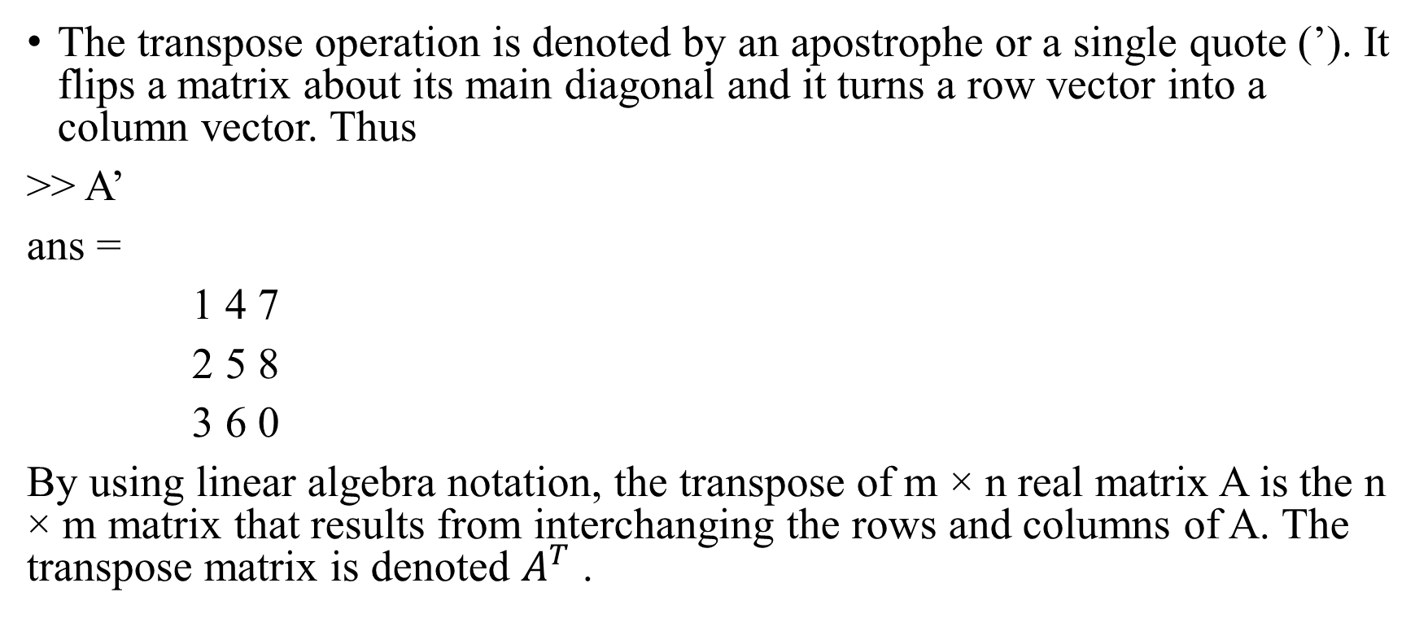
Transposing a matrix
The transpose operation is denoted by an apostrophe or a single quote (’). It flips a matrix about its main diagonal and it turns a row vector into a column vector. Thus
>> A’
ans =
1 4 7
2 5 8
3 6 0
By using linear algebra notation, the transpose of m × n real matrix A is the n × m matrix that results from interchanging the rows and columns of A. The transpose matrix is denoted $A^{T}$ .

Slide 27
Concatenating matrices
Matrices can be made up of sub-matrices. Here is an example. First, let’s recall our previous matrix A.
A =
1 2 3
4 5 6
7 8 9
The new matrix B will be,
>> B = [A 10*A; -A [1 0 0; 0 1 0; 0 0 1]]
B =
1 2 3 10 20 30

Slide 28
Continuation
B =
1 2 3 10 20 30
4 5 6 40 50 60
7 8 9 70 80 90
-1 -2 -3 1 0 0
-4 -5 -6 0 1 0
-7 -8 -9 0 0 1

Slide 29
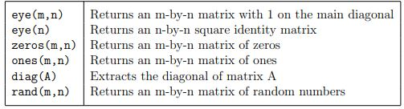
Matrix generators
MATLAB provides functions that generates elementary matrices. The matrix of zeros, the matrix of ones, and the identity matrix are returned by the functions zeros, ones, and eye, respectively.
Elementary matrices

Slide 30
Continuation
For a complete list of elementary matrices and matrix manipulations, type help elmat or doc elmat. Here are some examples:
1. >> b=ones(3,1) 2. >> eye(3)
b = ans =
1 1 0 0
1 0 1 0
1 0 0 1
Equivalently, we can define b as >> b=[1;1;1]

Slide 31
Continuation
3. >> c=zeros(2,3)
c =
0 0 0
0 0 0
In addition, it is important to remember that the three elementary operations of addition (+), subtraction (−), and multiplication (∗) apply also to matrices whenever the dimensions are compatible.
Two other important matrix generation functions are rand and randn, which generate matrices of (pseudo-)random numbers using the same syntax as eye.

Slide 32
Continuation
In addition, matrices can be constructed in a block form. With C defined by C = [1 2; 3 4], we may create a matrix D as follows
>> D = [C zeros(2); ones(2) eye(2)]
D =
1 2 0 0
3 4 0 0
1 1 1 0
1 1 0 1

Slide 33
Array operations and Linear equations
Matrix arithmetic operations
MATLAB allows arithmetic operations: +, −, ∗, and ˆ to be carried out on matrices. Thus,
A+B or B+A is valid if A and B are of the same size
A*B is valid if A’s number of column equals B’s number of rows
A^2 is valid if A is square and equals A*A
α*A or A*α multiplies each element of A by α

Slide 34
Array arithmetic operations
On the other hand, array arithmetic operations or array operations for short, are done element-by-element. The period character, distinguishes the array operations from the matrix operations. However, since the matrix and array operations are the same for addition(+) and subtraction (−), the character pairs (.+) and (.−) are not used. The list of array operators is shown below in Table. If A and B are two matrices of the same size with elements A = [aij ] and B = [bij ], then the command

Slide 35

Continuation
Array operators

Slide 36
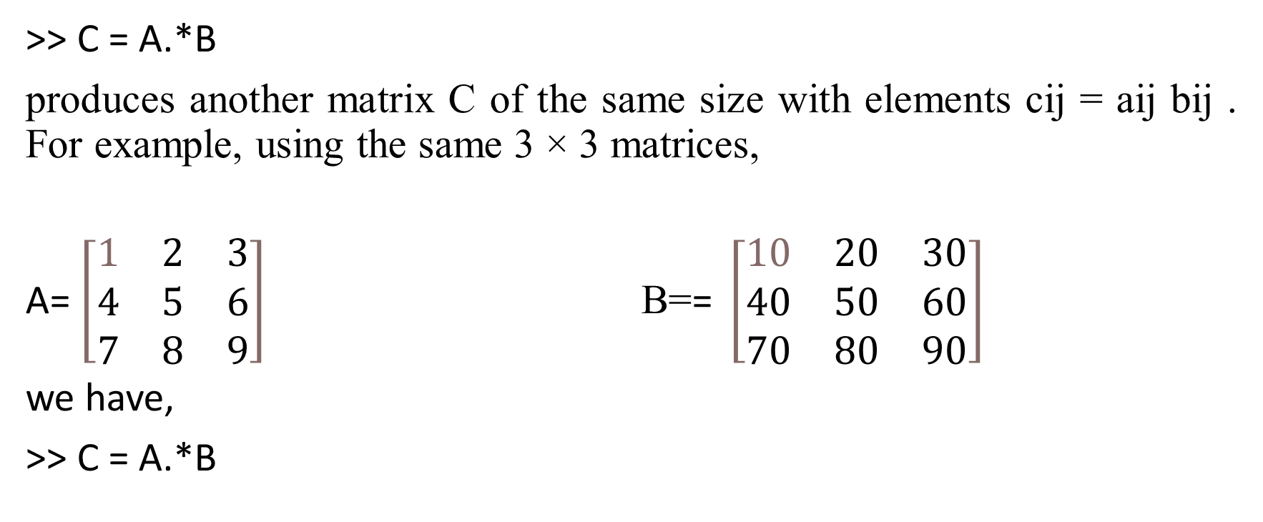
Continuation
>> C = A.*B
produces another matrix C of the same size with elements cij = aij bij . For example, using the same 3 × 3 matrices,
A= $\left[\begin{matrix}1 & 2 & 3 \\ 4 & 5 & 6 \\ 7 & 8 & 9\end{matrix}\right]$ B=$\text{= }\left[\begin{matrix}10 & 20 & 30 \\ 40 & 50 & 60 \\ 70 & 80 & 90\end{matrix}\right]$
we have,
>> C = A.*B

Slide 37
Continuation
C =
10 40 90
160 250 360
490 640 810
To raise a scalar to a power, we use for example the command 10^2. If we want the operation to be applied to each element of a matrix, we use .^2. For example, if we want to produce a new matrix whose elements are the square of the elements of the matrix A, we enter
>> A.^2

Slide 38
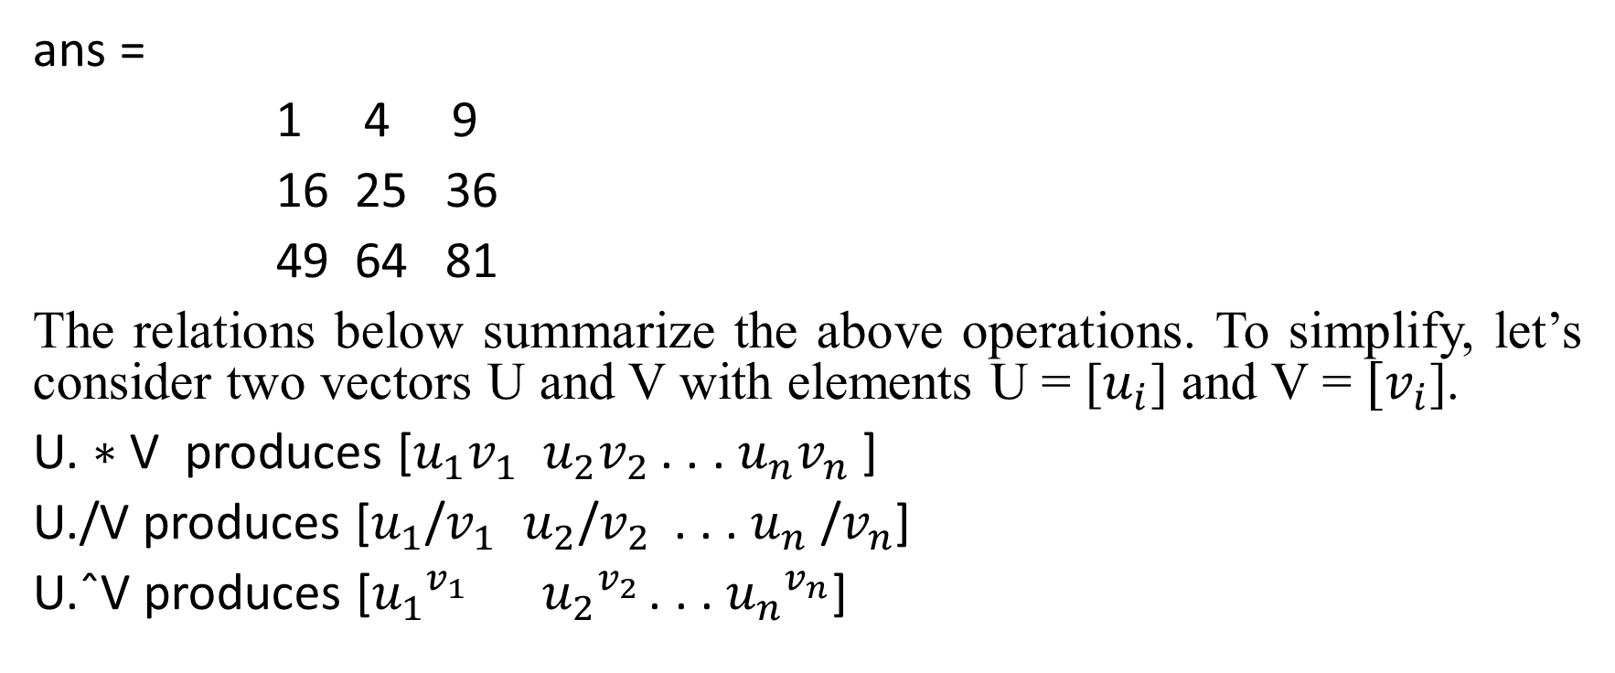
Continuation
ans =
1 4 9
16 25 36
49 64 81
The relations below summarize the above operations. To simplify, let’s consider two vectors U and V with elements U = [$u_{i}$] and V = ${[v}_{i}$].
U. ∗ V produces [$u_{1}v_{1}$ $u_{2}v_{2 }$. . . $u_{n}v_{n}$ ]
U./V produces [$u_{1}$/$v_{1}$ $u_{2}$/$v_{2 }$ . . . $u_{n}$/$v_{n}$]
U.ˆV produces [${u_{1}}^{v_{1}}$ ${u_{2}}^{v_{2 }}$. . . ${u_{n}}^{v_{n}}$]

Slide 39
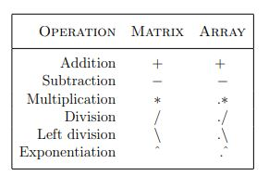
Continuation
Table : Summary of matrix and array operations

Slide 40
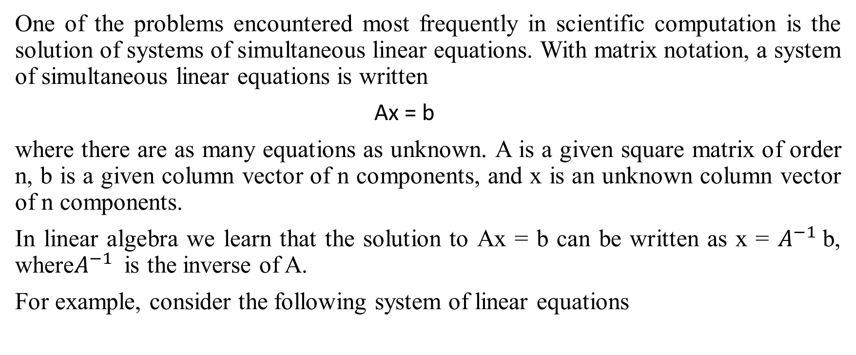
Solving linear equations
One of the problems encountered most frequently in scientific computation is the solution of systems of simultaneous linear equations. With matrix notation, a system of simultaneous linear equations is written
Ax = b
where there are as many equations as unknown. A is a given square matrix of order n, b is a given column vector of n components, and x is an unknown column vector of n components.
In linear algebra we learn that the solution to Ax = b can be written as x = $A^{−1}$b, where$A^{−1}$is the inverse of A.
For example, consider the following system of linear equations

Slide 41
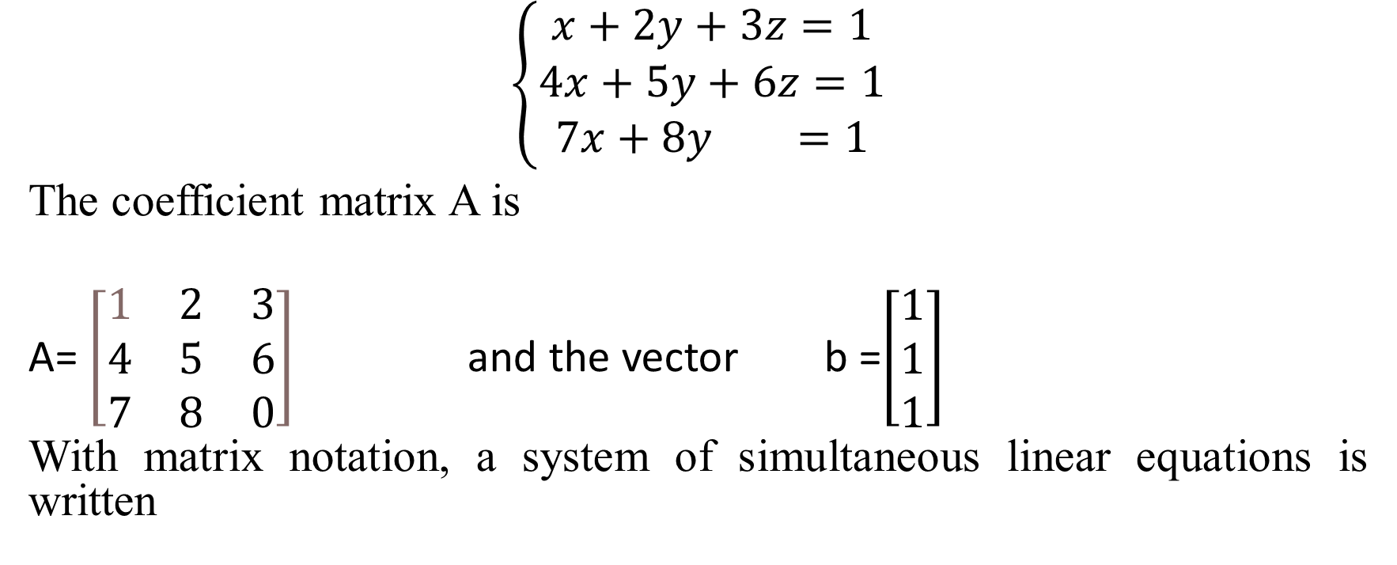
Continuation
$$\left\{\begin{aligned}x+2y+3z=1 \\ 4x+5y+6z=1 \\ 7x+8y =1\end{aligned}\right.$$
The coefficient matrix A is
A= $\left[\begin{matrix}1 & 2 & 3 \\ 4 & 5 & 6 \\ 7 & 8 & 0\end{matrix}\right]$ and the vector b =$\left[\begin{aligned}1 \\ 1 \\ 1\end{aligned}\right]$
With matrix notation, a system of simultaneous linear equations is written

Slide 42
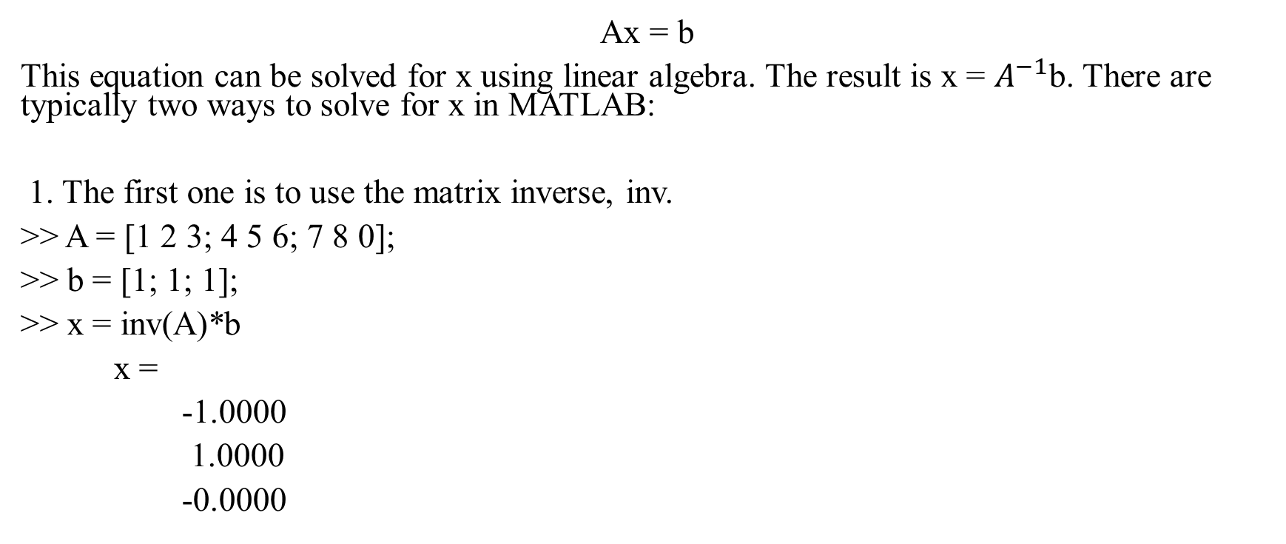
Continuation
Ax = b
This equation can be solved for x using linear algebra. The result is x = $A^{−1}$b. There are typically two ways to solve for x in MATLAB:
1. The first one is to use the matrix inverse, inv.
>> A = [1 2 3; 4 5 6; 7 8 0];
>> b = [1; 1; 1];
>> x = inv(A)*b
x =
-1.0000
1.0000
-0.0000

Slide 43
Continuation
The second one is to use the backslash (\)operator. The numerical algorithm behind this operator is computationally efficient. This is a numerically reliable way of solving system of linear equations by using a well-known process of Gaussian elimination.
>> A = [1 2 3; 4 5 6; 7 8 0];
>> b = [1; 1; 1];
>> x = A\b
x =
-1.0000
1.0000
-0.0000

Slide 44
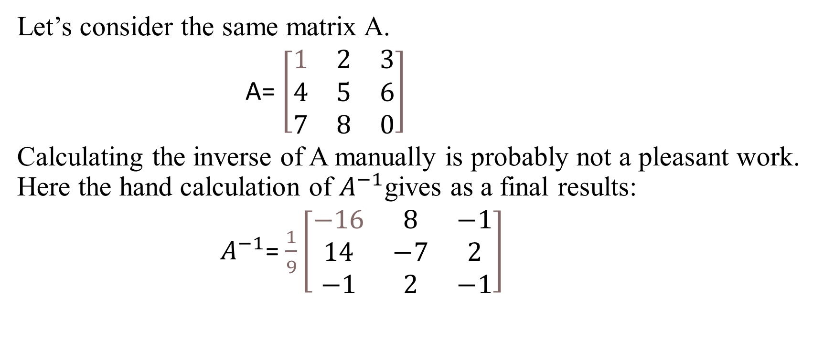
Matrix inverse
Let’s consider the same matrix A.
A= $\left[\begin{matrix}1 & 2 & 3 \\ 4 & 5 & 6 \\ 7 & 8 & 0\end{matrix}\right]$
Calculating the inverse of A manually is probably not a pleasant work. Here the hand calculation of $A^{−1}$gives as a final results:
$A^{−1}$= $\frac{1}{9}\left[\begin{matrix}−16 & 8 & −1 \\ 14 & −7 & 2 \\ −1 & 2 & −1\end{matrix}\right]$

Slide 45
Continuation
In MATLAB, however, it becomes as simple as the following commands:
>> A = [1 2 3; 4 5 6; 7 8 0];
>> inv(A)
ans =
-1.7778 0.8889 -0.1111
1.5556 -0.7778 0.2222
-0.1111 0.2222 -0.1111

Slide 46

Continuation
which is similar to:
$A^{−1}$= $\frac{1}{9}\left[\begin{matrix}−16 & 8 & −1 \\ 14 & −7 & 2 \\ −1 & 2 & −1\end{matrix}\right]$
and the determinant of A is
>> det(A)
ans =
27

Slide 47
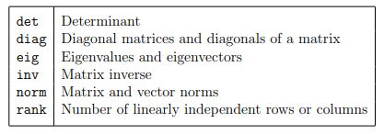
Matrix functions
MATLAB provides many matrix functions for various matrix/vector manipulations; see Table for some of these functions. Use the online help of MATLAB to find how to use these functions.
Table : Matrix functions

Slide 48
THANK YOU

